Slide 1

Iteration 3
Computer Science Project Portal

Slide 2
Iteration 3 Completions
Focused on website flow design and implementation
Standardizing site architecture
Finalize site flow diagrams and build flow skeleton on site
Update documentation with new site flow and design
Notes:
J

Slide 3
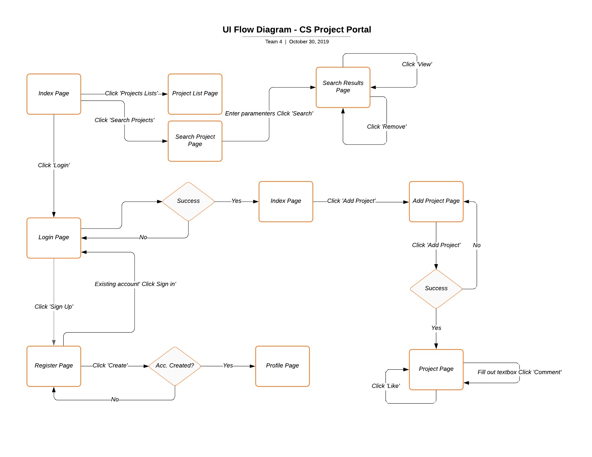
UI Flow Diagram
Notes:
J

Slide 4
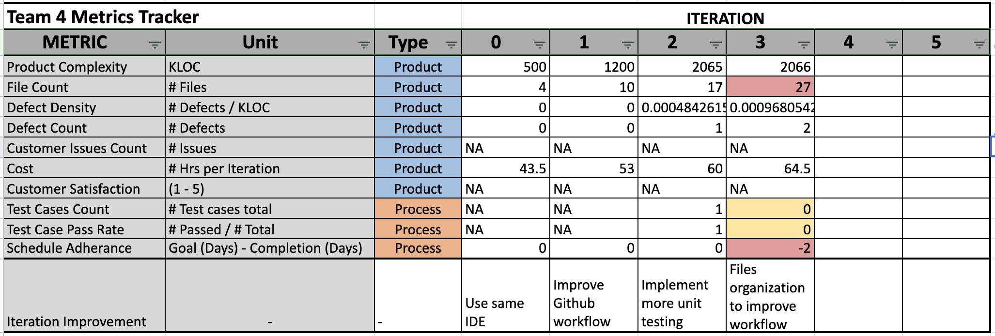
QUALITY METRICS SUMMARY
Notes:
J

Slide 5
Iteration 3 Retrospective and Process Improvement
Improvements to version control and the deploy process
Adding more in depth documentation to decrease confusion
Building site flow framework this iteration enables future page buildout with low lift
Notes:
J

Slide 6
Methods and Files/Pages
Home.html
Login looks like it is there but it does not currently work.
No methods yet
AddProject.cshtml
Uses html5 form with post as action.
On post, connect to database, run sql query using the data given by the form.
SubmitSearch.cshtml
Uses html5 form to collect user data and post.
Collects desired strings from form, then sends them as a response.redirect() to a url and adds the strings to the url in order to grab data from another page.
SearchResults.cshtml
First looks at URL for any strings to grab.
It has intelligent if else statements to build a query string based on what is found in the url.
Executes query and displays a card view for each result found.
Sign-up.html
Looks like it is there, but it does not currently work.
No methods yet
Notes:
J

Slide 7
Coding Smell
Bad Smells
Large Class
Duplicate code
Long Parameter Lists
Lack of comments
Files organization doesn’t not reflect site architecture
Notes:
R

Slide 8
Testing Plan
-To ensure that the potential visitors can fully experience a site and are encouraged to visit again
Test Categories
Correct layout
Hyperlink work(page based, external, internal, emails)
Scripting work correctly (ASP.net, form validation)
All images displayed
Other browser compatible
Text has no spelling error
Notes:
R

Slide 9
Testing Results
Test | User Requirement Addressed | Expected Results | Actual Results | Pass/Fail | Date | Correction Action
Logo Display |  | CS portal logo displayed | As expected | Pass | 10/31 | None
Navigate bar appear | Easy to navigate | Navigate bar appeared | As expected | Pass | 10/31 | None
Navigate bar drop down work | Easy to navigate | When mouse goes over labels, menu drop down | As expected | Pass | 10/31 | None
Navigate bar hyperlink work | Easy to navigate | When mouse goes over turn to yellow and cna click on it to take to correct page | As expected | Pass | 10/31 | None
Notes:
R

Slide 10
Informational

Slide 11
Design Pattern and Site Architecture (3 Tier)
Design Pattern:
The team has implemented structural design patterns at the database design level to organize two different types of users, which can be students and faculty. Users will have their respective distinctive attributes at the subclass level (STUDENT and FACULTY), and common attributes at the super class level USER.
Site Architecture
1. Presentation layer (Users Browser):
a. HTML
b. Java Script
c. Jquery
d. Css
2. Application Layer
a. C# Razor (.cshtml files)
b. Communicates to presentation layer via URL Querying
3. Data Layer
a. Sql server. Receives commands from Application Layer.
Notes:
J

Slide 12
Site Deployment Steps
Bought domain name for $10 a year: http://www.computerscienceprojectportal.com
Was already subscribed to a hosting service form Arvixe. They deploy the site to the domain, and give us:
FTP to files of the server
SQL databases
There are separate logins for the FTP and Database.
As well as different software to access them. We use Microsoft SQL Server Management Studio for sql and Atom as an IDE for html pages.
Every time we are comfortable with code in master branch, Files are migrated to our server.
Then test the new files on the server.
Notes:
J

Slide 13
Appendix

Slide 14
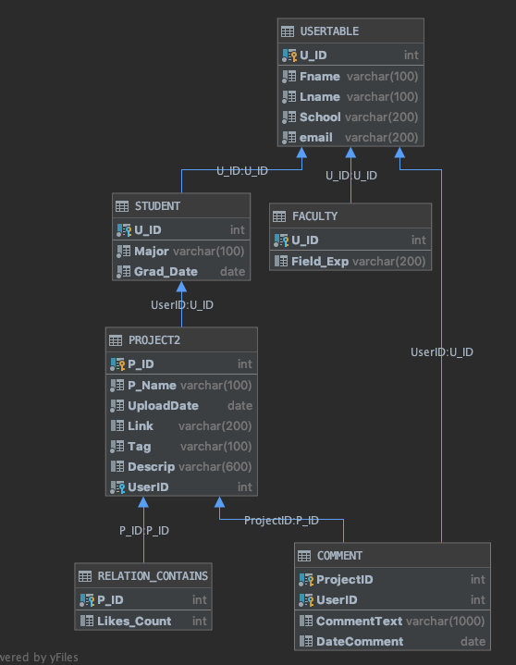
DESIGN ARCHITECTURE
DB Architecture fully implemented in MS SQL Server
Developed and implemented constraints to avoid data anomalies
Sample tuples created to display functionality
Pending SQL Unit Testing with tuples
Notes:
J

Slide 15
UI Design
Support all screen devices
More user friendly design
Modern Look
Toggle Navbar
Notes:
R

Slide 16
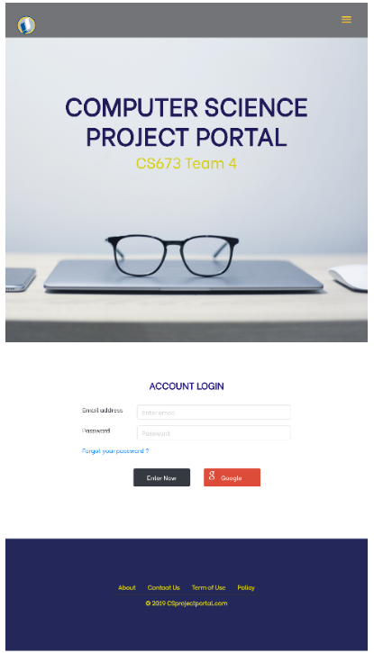
Tablet & Mobile Screen
Hamburger bar
Toggle navbar
Notes:
R

Slide 17
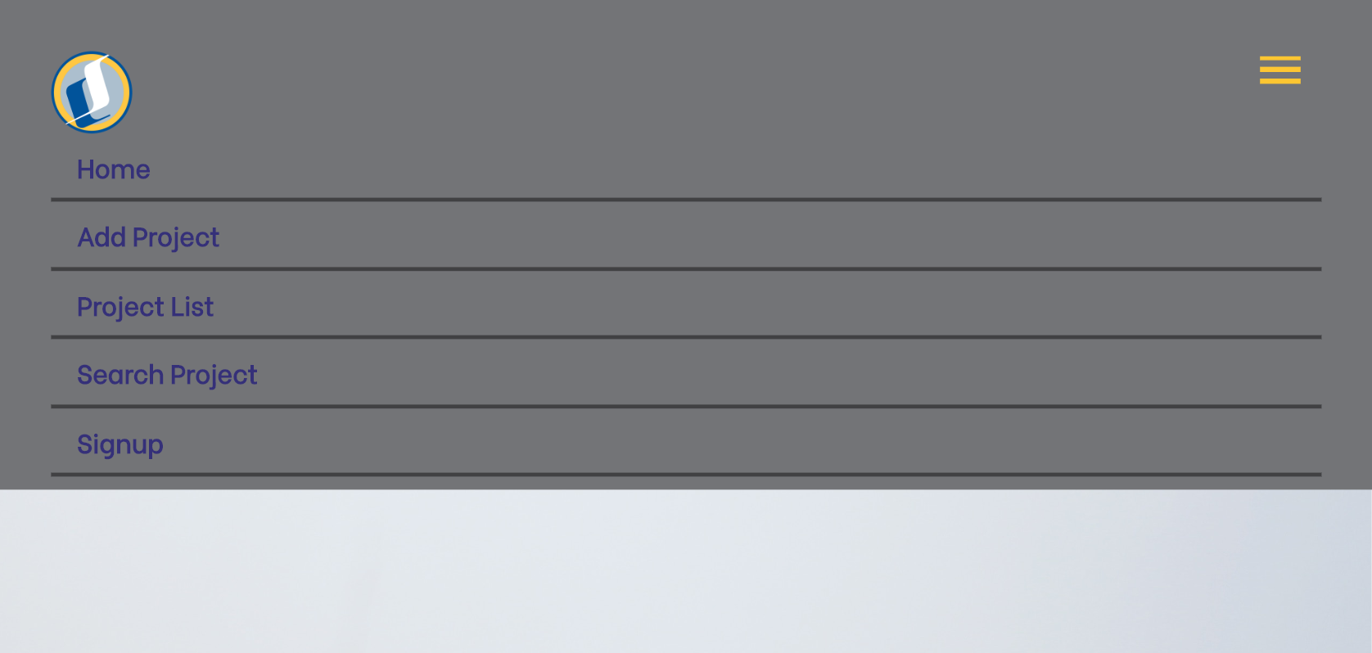
Notes:
R

Slide 18
Next iteration Plan
-Refactoring Coding Design
-Log in/out feature
-Style add project and project list
- Sign up users
- Unit Testing for Google Login

